Slide 1
Q-Learning Based Dynamic Drone Trajectory Planning in Uncertain Environments
Subrahmanya Chandra Bhamidipati, Adam Maxwell, Emily Pham, Johann Zhang, Zack Murry, Alicia Esquivel Morel, Chengyi Qu, Sharan Srinivas, Prasad Calyam
Still working on beautifying the template of the presentation. More concerned about the content at the time

Slide 2
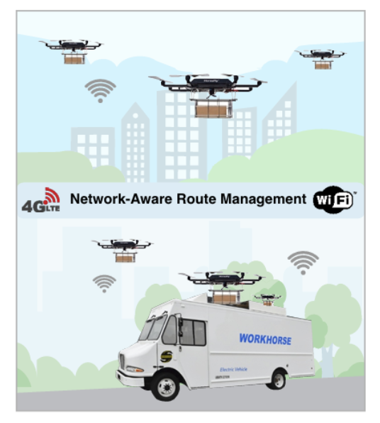
Revolutionizing Last-Mile Delivery
Drones increasingly used in logistics, urban deliveries, disaster relief, smart farming, ...
Problem:
Drones face connectivity and navigation challenges in dynamic environments.
Objective:
Realize use cases for network-aware route management involving electric trucks used for last-mile parcel delivery with drones (e.g., Workhorse)
Introduce Q-learning-based model to enable drones to adapt to network disruptions.
Ensure safety and efficient delivery even without continuous communication with ground control.
Network-aware route management between drone and truck in last-mile parcel delivery operations

Slide 3
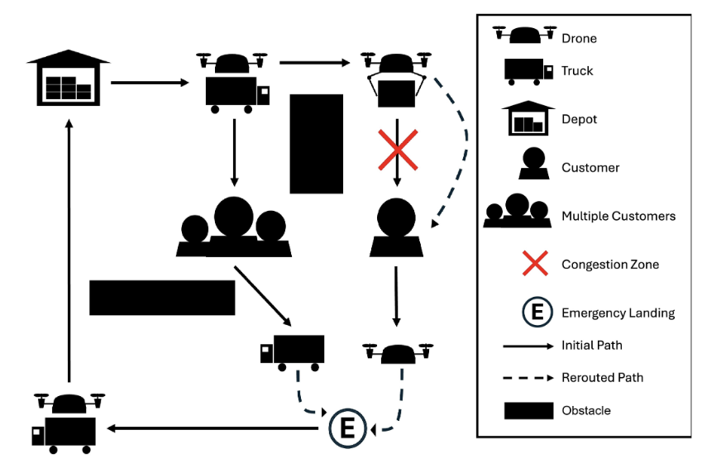
Navigating Challenges
Core Challenges:
Unstable Network Connectivity: Obstacles (e.g., wind, trees, buildings), or network congestion (e.g., flooding attack, heavy cross traffic), distance/low battery levels (i.e., low signal strength) cause communication loss between drone and GCS.
Dynamic Environments: Require drones to navigate around obstacles or traffic congestion zones.
Goal: Enable drones to independently make safe, real-time decisions during network disruption events that meet operator preferences.
Illustration of drone trajectory navigation in a dynamic environment with obstacles and congestion zones.

Slide 4
Related Work and Novelty
Existing Models: Rely on continuous connectivity; struggle with disconnections.
Traditional Algorithms: Static path-planning (A*) lacks adaptability.
RL Advances: Some RL models exist but assume constant network access.
Novel Approach: Uses Q-learning for independent, adaptive routing under network loss.
Real-Time Adaptation: Responds to congestion, obstacles, and connectivity issues.
Enhanced Performance: Outperforms A* by 23% in dynamic environments.

Slide 5
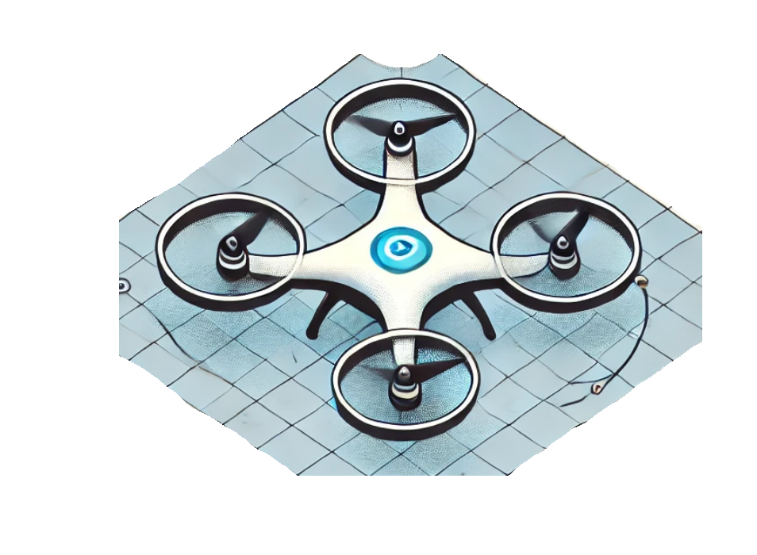
Q-Learning for Intelligent Drone Decisions
Markov Decision Process (MDP):
State Space: Drone’s position, obstacles, network status, battery level, in congestion, nearest congestion.
Action Space: Movement in eight directions; accelerate/decelerate.
Reward Structure:
Positive Rewards: Delivery, Reaching depot, Emergency landing spot.
Negative Rewards: Battery depletion, Congestion entry, Collisions.
Reward
Next
State
Action
State
Illustration of the Q-learning cycle

Slide 6
Q-learning Problem Formalization
Identifying network uncertainties
Physical Obstacles: Structures and trees block signals, causing connectivity loss.
Congestion: High data traffic leads to delays and packet loss
Signal Fading: Signal weakens over distance, with weather further degrading connectivity.
Real-Time Detection: Sensors monitor signal quality to identify disruptions instantly.
Decision making for mission adaptation
Adaptive Routing: Adjusts path to restore connection when disrupted.
Pre-emptive Decision-Making: Assesses risk and decides on safe alternatives if disconnection persists.

Slide 7
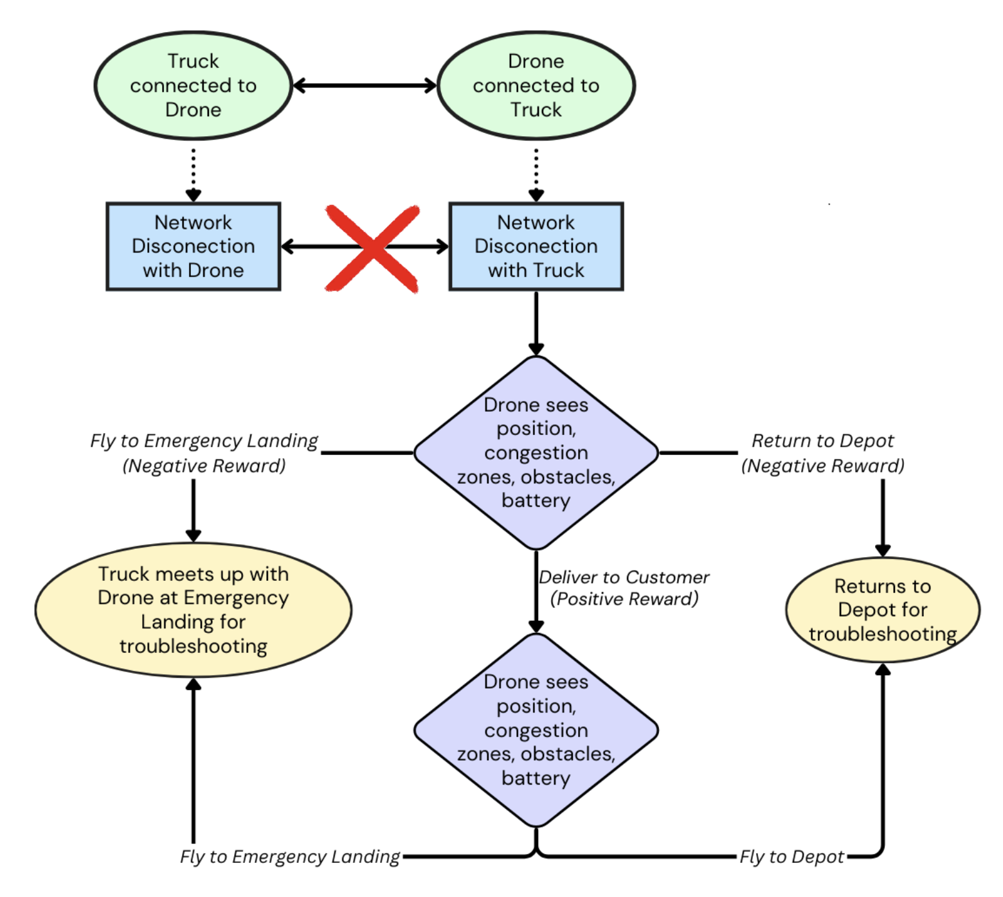
Q-learning Solution Approach
Decision-Making Framework: Based on real-time conditions and learned policy
Continuing to the delivery point
Returning to the depot
Heading to an emergency landing spot
Complexity Analysis:
Time complexity O(∣S∣×∣A∣×N)
Space complexity O(∣S∣×∣A∣)
Decision making Framework of Drone

Slide 8
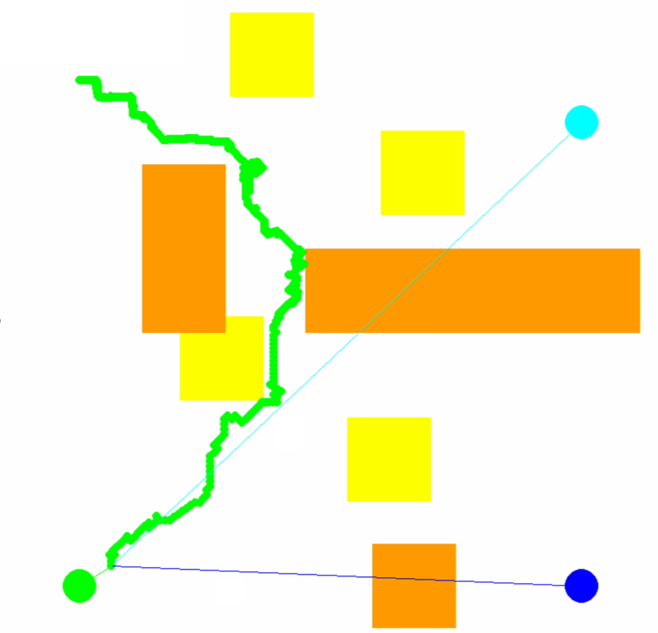
Testing in Simulations
Assumptions:
Single Drone, Single GCS
Simulation Environment:
Grid Setup: 800x800 pixel environment.
Grid Elements: Start/end positions, emergency landing spots, depot, dynamic congestion zones.
Simulation Parameters:
Episodes: 100,000 for training.
Model Comparisons:
Q-learning for dynamic path-finding tasks (Our Approach)
A* (State-of-the-Art) for static well-defined path-finding tasks
Depot
Obstacle
800 px
Cong.
Zone
Emergency Landing Spot
Customer
800 px
Environment setup in simulations

Slide 9
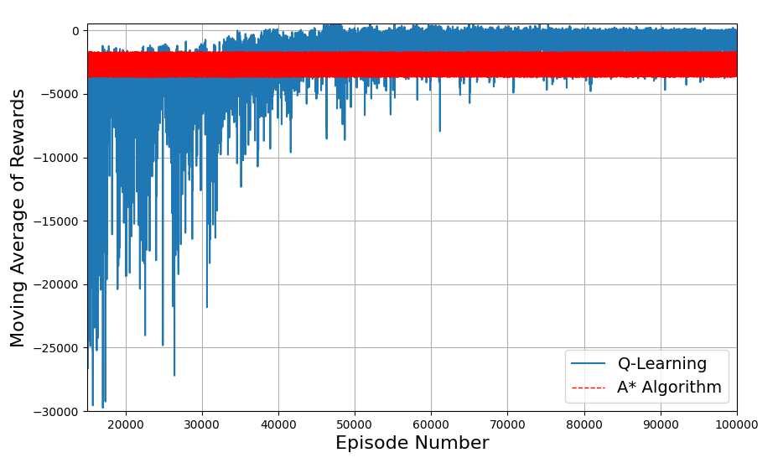
Results
Experiment Goal:
Evaluate Q-learning in dynamic environments with connectivity issues.
Compare rewards against A* for adaptability.
Performance Analysis:
Reward Comparison: Q-learning shows 23% higher reward accumulation than A*.
Reward comparison of Q-learning with A*

Slide 10
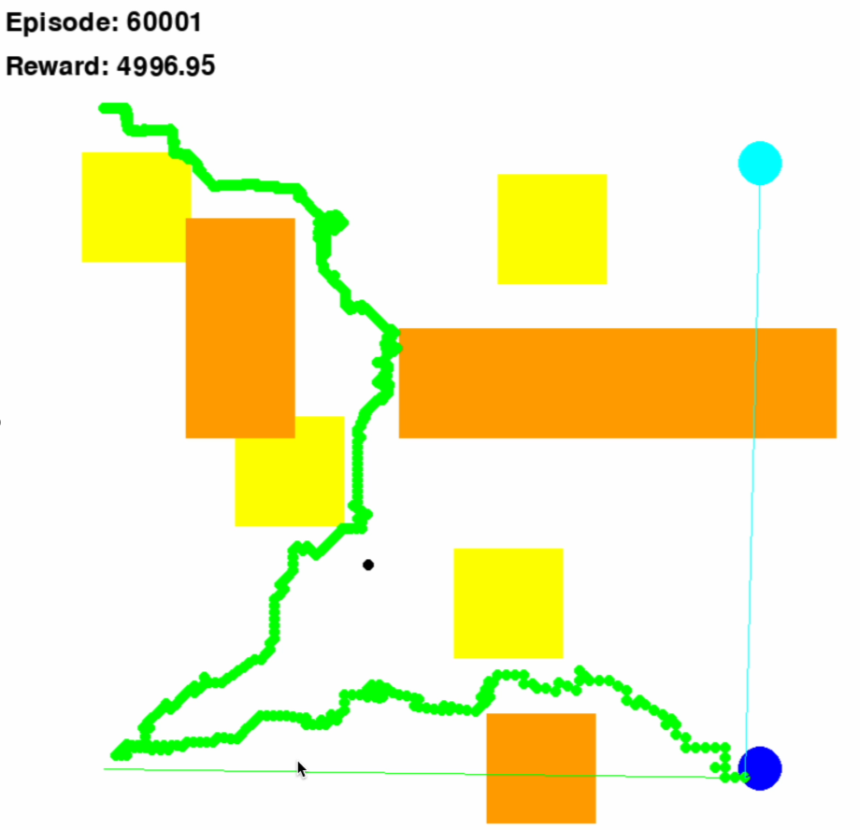
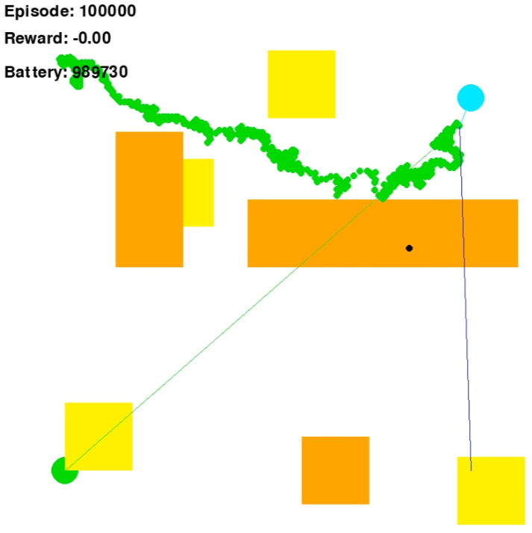
Scenario Analysis
Observations:
Dynamic Path Adjustment
Safety-First Navigation
Scenario 1: Drone successfully completes delivery, lands at an emergency site to ensure safety.
Scenario 2: Drone abandons delivery and returns to depot if delivery becomes too risky

Slide 11
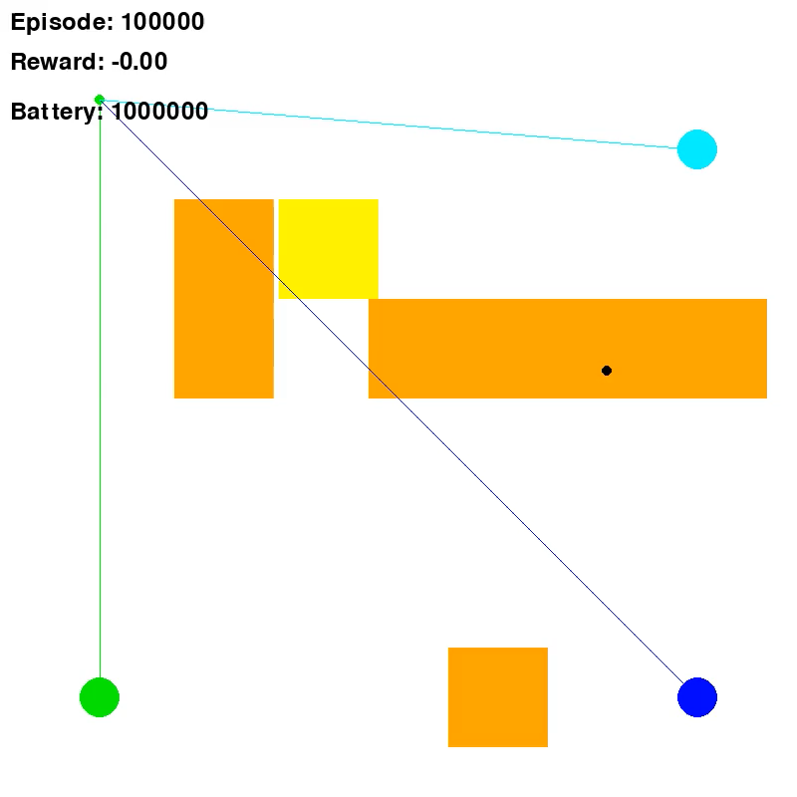
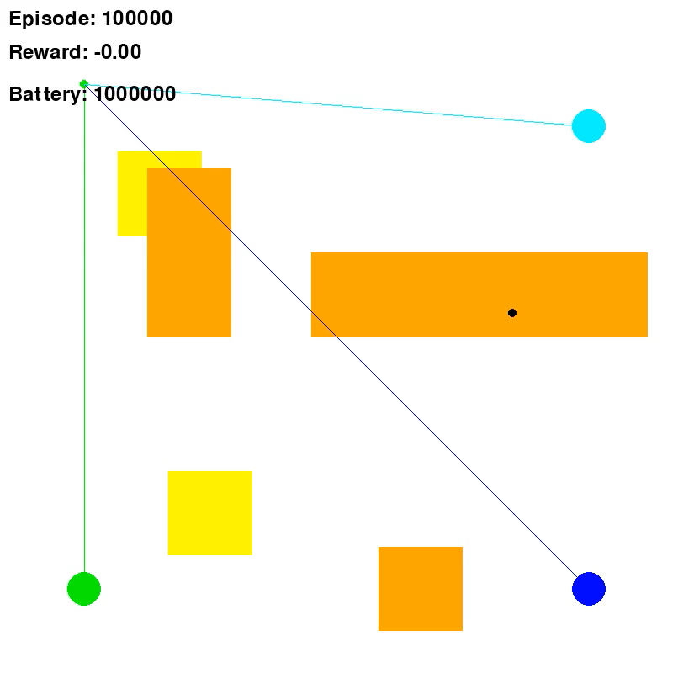
Animations
Scenario 1: Drone successfully completes delivery, lands at an emergency site to ensure safety.
Scenario 2: Drone abandons delivery and returns to depot if delivery becomes too risky

Slide 12
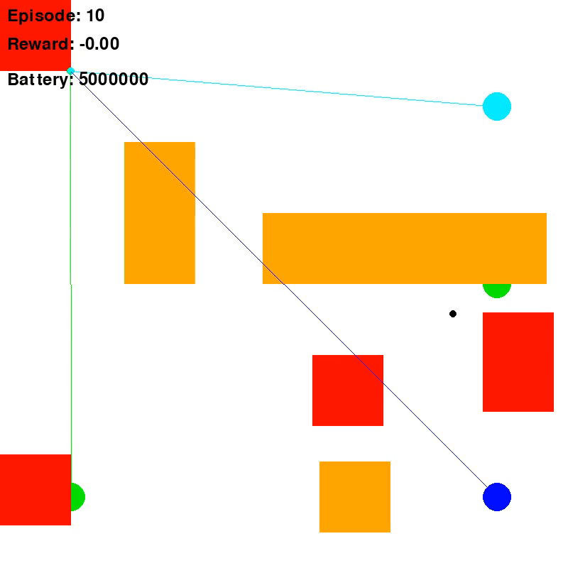
Improvements since paper
Expanded simulation to a multi drone system

Slide 13
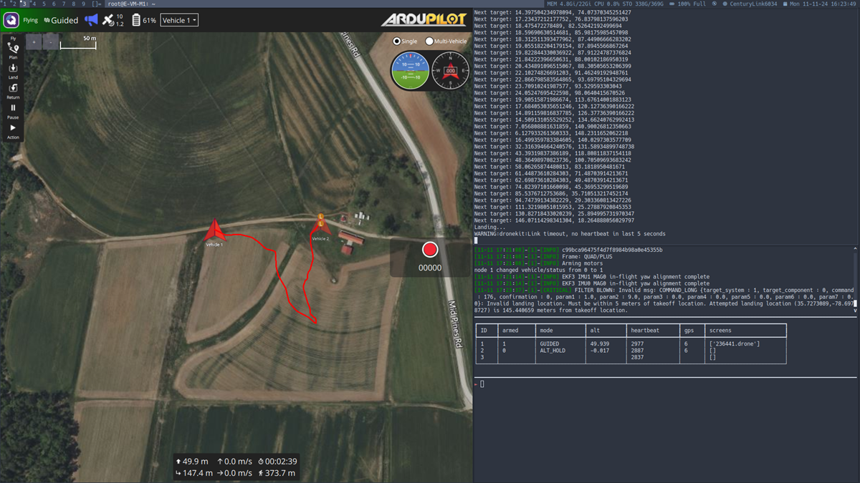
Improvements since paper
Began real-world testing on AERPAW testbed.

Slide 14
Conclusion
Key Insights:
Safety: Prioritizes safe recovery and avoids high-risk situations in event of network partitions.
Energy Efficiency: Balances successful deliveries with energy conservation for longer missions.
Flexibility: Enables real-time adaptation without continuous supervision of drone operator.
Limitations:
Higher computational load with expanding environment complexity.
Rewards need to match operator preferences
Future Work:
Multi-drone scenarios
Advanced RL algorithms such as DQN, PPO.
Real-world field testing in NSF-supported AERPAW infrastructure to validate model.

